Slide 1
Final Project
Slagjana Nakevska

Slide 2
Coursera Capstone - REPORT
Content
Introduction Section :
1.1 Discussion of the "background situation" leading to the problem at hand:
1.2 Problem to be resolved
1.3 Audience for this project.
Data Section:
2.1 Data of Current Situation (current residence place)
2.2 Data required to resolve the problem
2.3 Data sources and data manipulation Methodology section :
3.1 Process steps and strategy to resolve the problem
3.2 Data Science Methods, machine leering, mapping tools and exploratory data analysis.
Results section
Discussion of the results and how they help to take a decision.
Discussion section
Elaboration and discussion on any observations and/or recommendations for improvement.
Conclusion section
Decision taken and Report Conclusion.

Slide 3
Introduction Section
Scenario and Background I currently live within walking distance to Downtown, therefore I have access to good public transportation to work. Likewise, I enjoy many amenities in the neighborhood , such as international cousin restaurants, cafes, food shops and entertainment.
I have been offered a great opportunity to work in Manhattan, NY. Although, I am very excited about it, I am a bit stress toward the process to secure a comparable place to live in Manhattan. Therefore, I decided to apply the learned skills during the Coursera course to explore ways to make sure my decision is factual and rewarding. Of course, there are alternatives to achieve the answer using available Google and Social media tools, but it rewarding doing it myself with learned tools.
Problem to be resolved:
The challenge to resolve is being able to find a rental apartment unit in Manhattan NY that offers similar characteristics and benefits to my current situation. Therefore, in order to set a basis for comparison, I want to find a rent unit subject to the following conditions:
Apartment with min 2 bedrooms with monthly rent not to exceed US $7000/month Unit located within walking distance (<=1.0 mile, 1.6 km) from a subway metro station in Manhattan Area with amenities and venues

Slide 4
Data Section
In order to make a good choice of a similar apartment in Manhattan NY, the following data is required:
List/Information on neighborhoods form Manhattan with their Geodata latitude and longitude.
List/Information about the subway metro stations in Manhattan with geodata.
Listed apartments for rent in Manhattan area with descriptions ( how many beds, price, location, address) Venues and ammenities in the Manhattan neighborhoods

Slide 5
Methodology section
what is the cost of available rental places that meet the demands?
what is the cost of rent around a mile radius from each subway metro station?
what is the area of Manhattan with best rental pricing that meets criteria established?
What is the distance from work place ( Park Ave and 53 rd St) and the tentative future rental home? What are the venues of the two best places to live? How the prices compare?
How venues distribute among Manhattan neighborhoods and around metro stations?
Are there tradeoffs between size and price and location? Any other interesting statistical data findings of the real estate and overall data.

Slide 6
RESULTS

Slide 7
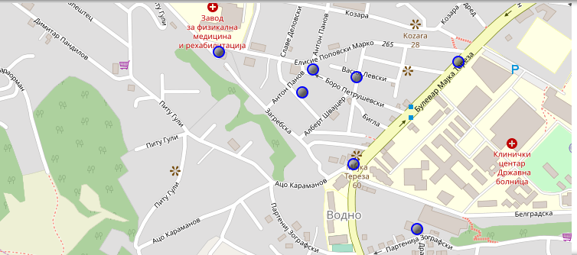
Current residence neighborhood in skopje

Slide 8
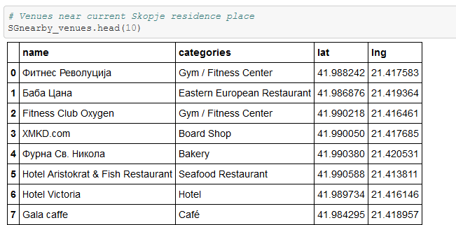
Venues Around neighborhood

Slide 9
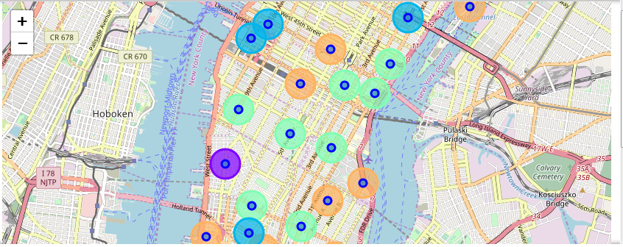
MANHATTAN NEIGHBORHOODS and Cluster of venues

Slide 10
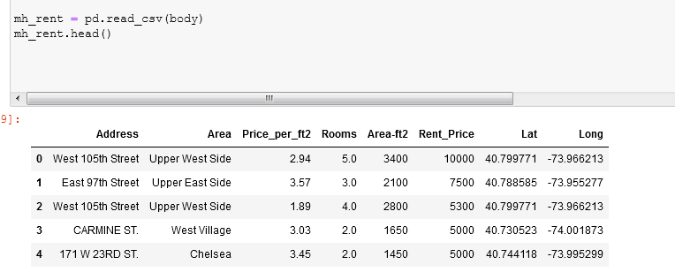
Geodata MANHATTAN apts for rent

Slide 11
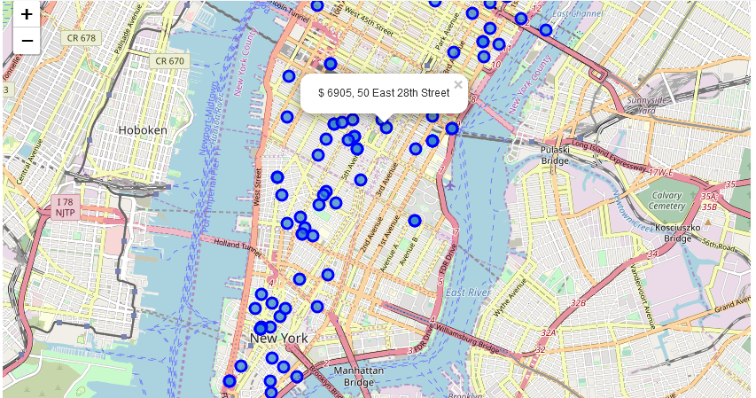
Apartments for rent in MH

Slide 12
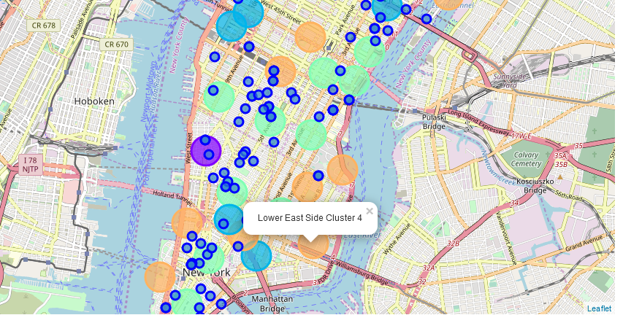
Mh apartments for rent with venue clusters

Slide 13
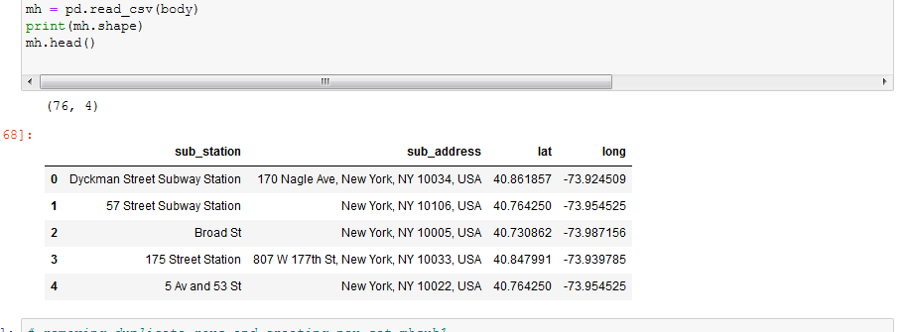
Mh subway station data

Slide 14
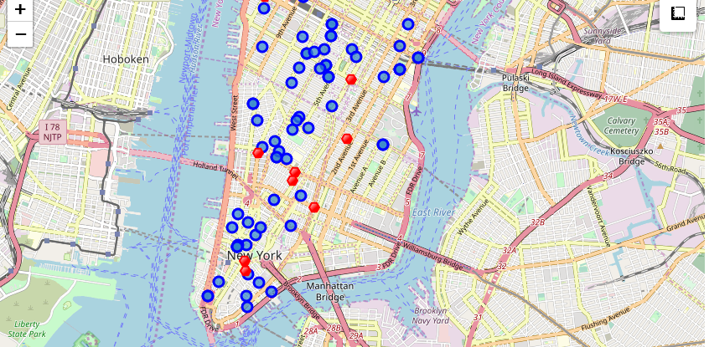
App for rent (Blue) and subway station (Red)

Slide 15
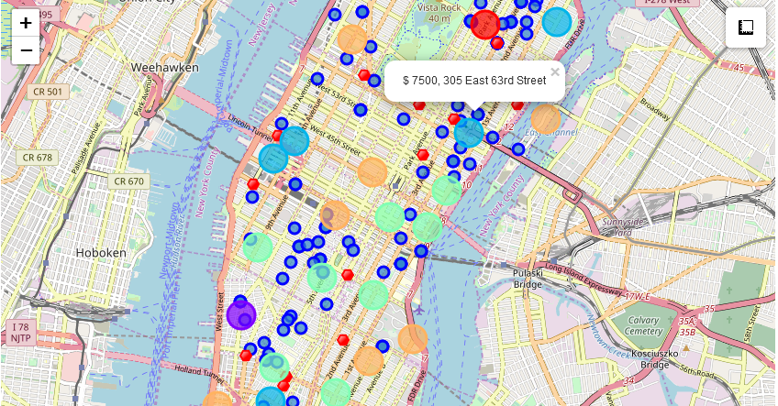
Selected app
305 East 63rd Street in the Sutton Place Neighborhood and near 'subway 59th Street' station, Cluster # 2 Monthly rent : 7500 Dollars

Slide 16
Apartment selection
Using the "one map" above, I was able to explore all possibilities since the popups provide the information needed for a good decision.
Apartment 1 rent cost is US7500 slightly above the US7000 budget. Apt 1 is located 400 meters from subway station at 59th Street and work place ( Park Ave and 53rd) is another 600 meters way. I can walk to work place and use subway for other places aroung. Venues for this apt are as of Cluster 2 and it is located in a fine district in the East side of Manhattan.
Apartment 2 rent cost is US6935, just under the US7000 budget. Apt 2 is located 60 meters from subway station at Fulton Street, but I will have to ride the subway daily to work , possibly 40-60 min ride. Venues for this apt are as of Cluster
I feel that Cluster 2 type of venues is a closer resemblance to my current place. That means that APARTMENT 1 is a better choice since the extra monthly rent is worth the conveniences it provides.

Slide 17
discussion
In general, I am positively impressed with the overall organization, content and lab works presented during the Coursera IBM Certification Course
I feel this Capstone project presented me a great opportunity to practice and apply the Data Science tools and methodologies learned.
I have created a good project that I can present as an example to show my potential.

Slide 18
conclusion
I feel rewarded with the efforts, time and money spent. I believe this course with all the topics covered is well worthy of appreciation.
This project has shown me a practical application to resolve a real situation that has impacting personal and financial impact using Data Science tools.
The mapping with Folium is a very powerful technique to consolidate information and make the analysis and decision thoroughly and with confidence. I would recommend for use in similar situations.

